Slide 1
ArcGIS Essentials
Basics of ArcGIS from Online Tutorials. MUST be viewed as a slideshow to see the process flow. Run it Auto or with the timings turned off. (SlideShow | uncheck Use Timings)
Ref: https://learn.arcgis.com/en/projects/get-started-with-arcgis-online/
ACKNOWLEDGEMENT
This presentation is derived from the above page, with navigation and explanations added to simplify the learning process. While the presentation in its entirety remains the property of NCI, the knowledge base and some graphics in the above URL are owned by ESRI
Copyright © 2019 by National Computational Infrastructure, Canberra, ACT, Australia. Author: Dr. Arapaut V Sivaprasad.
8 January, 2018

Slide 2
Contents
This tutorial aims to give basic understanding on the following:
Introduction to ArcGIS Online
Sign Up and Sign In
Basic usage
Create a map
Change styles
Add demographic data
View attribute table
Style the layer with attribute
Style with normalized data
Customise the pop-up
Create a web app
Adding GSKY Web Map Service
Advanced usage
TL;DR

Slide 3
Lesson Plan
Create a map | Create a map showing evacuation routes in Houston. | 10 minutes
Identify spatial patterns | Use smart mapping and pop-ups to determine areas with low vehicle ownership. | 20 minutes
Create an app | Configure a web app to share your findings with others. | 15 minutes

Slide 4
Summary
In this tutorial, you will learn to create a map, add layers, add demographic data, etc. as shown below. This is a beginner’s lesson to get started with ArcGIS, and does not cover all options and advanced functions.
‘ArcGIS Online’ is used here. ‘ArcGIS Pro Desktop’ can achieve the same result, but the process is different.
Sign up and/or Sign in
Create a map
Click ‘Map’ and zoom to an area
via mouse wheel
Searching for ‘Houston’
Add a layer
‘Hurricane Evacuation Routes’
Change the base map and line styles
Save map
Set map for share
Add demographic data
Add the layer, ‘Houston Demographics by Census Tracts’ to the map
View the attribute tables
Style the layer with attribute data
Normalise the style data
Customise the Pop-up
Create a web App
Copy the public URL of the web app.
Next: Details

Slide 5
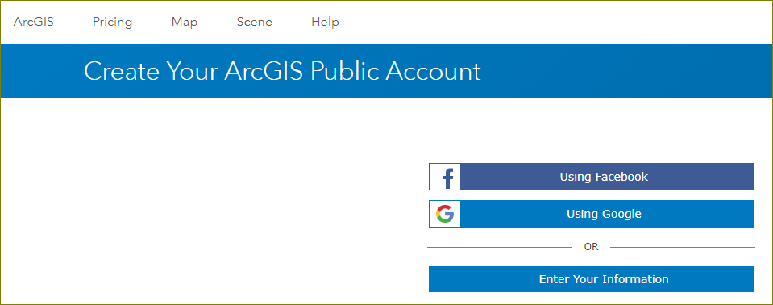
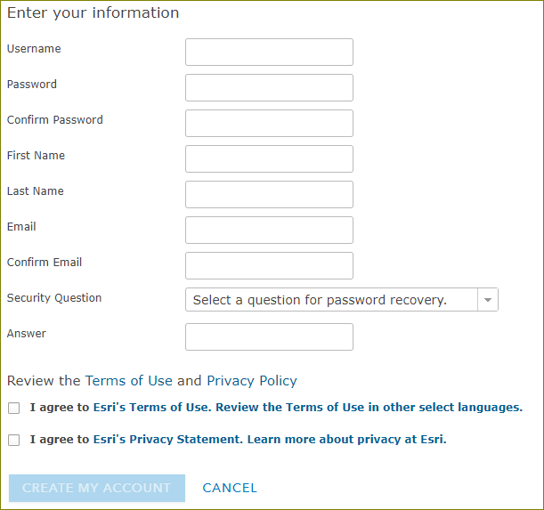
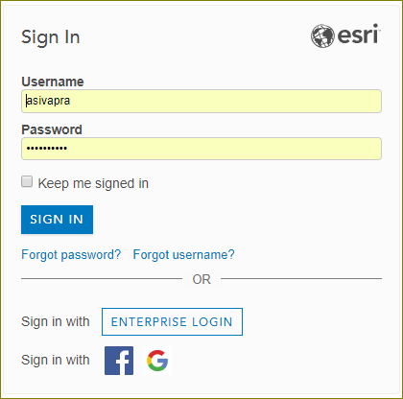
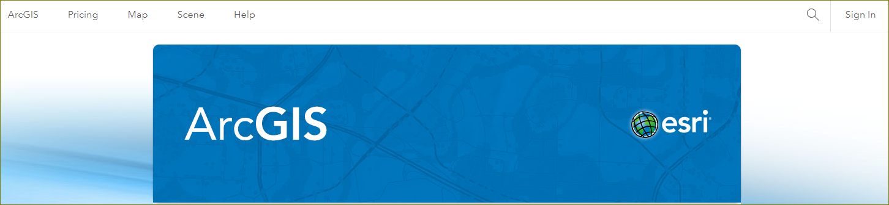
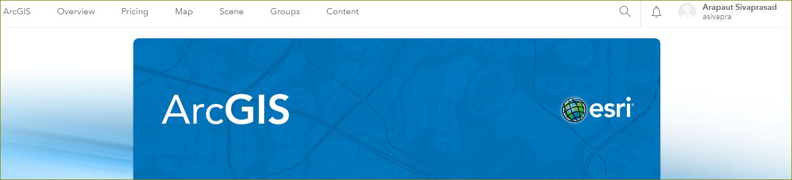
Sign Up and Sign In
In this lesson, you'll create a map that shows hurricane evacuation routes in Houston, Texas. First, you'll create a new map and locate Houston, Texas. Then, you'll add a map layer that shows evacuation routes. Lastly, you'll change the way your map and layers look to better display the data.
If you don't have an ArcGIS account, you can sign up for a free public account or an ArcGIS free trial.
Sign Up: https://www.arcgis.com/home/createaccount.html
Sign In: https://www.arcgis.com/home/index.html
Next: Create a Map

Slide 6
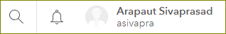
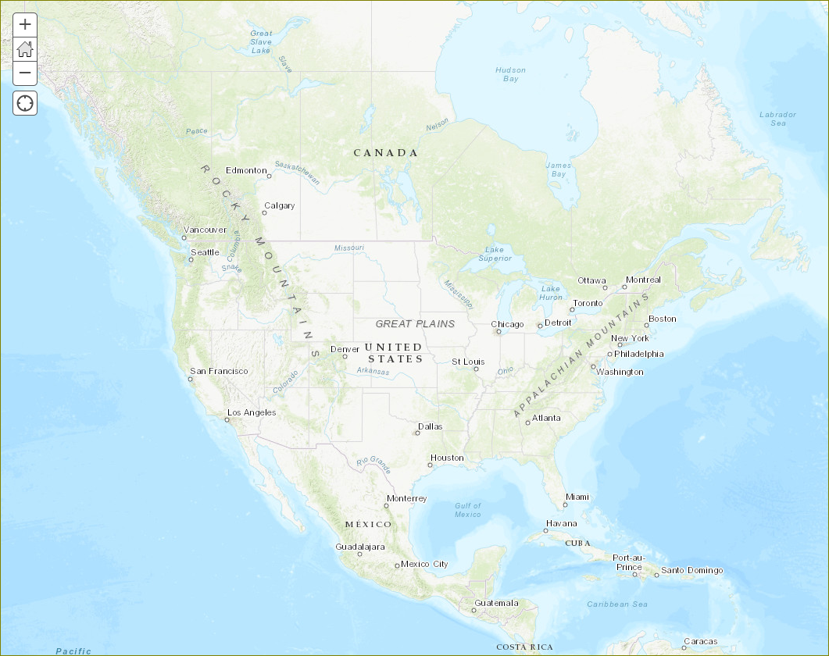
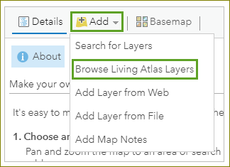
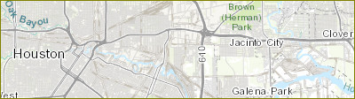
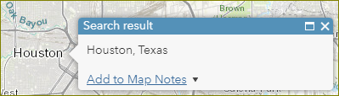
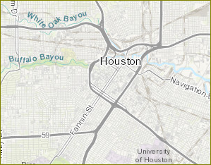
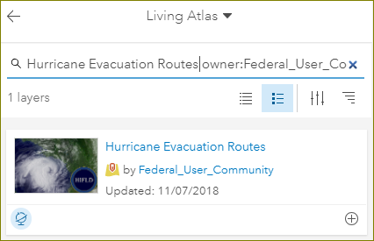
Create a Map
1. Click ‘Map’ and zoom to USA.
2. Search for ‘Houston’.
3. Dismiss the ‘Search result’ box.
4. Zoom until ‘Buffalo Bayou’ is visible.
5. Click ‘Add | Browse Living Atlas Layers’.
6. Type in ‘Hurricane Evacuation Routes owner:Federal_User_Community’.
7. Click the Add button (+)
Next: Change Styles

Slide 7
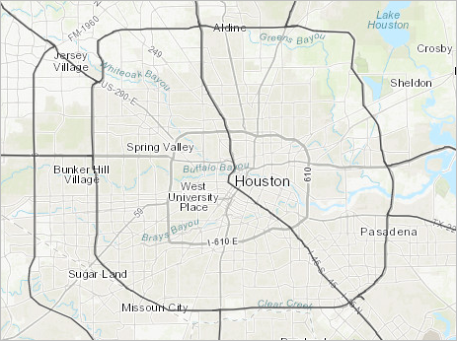
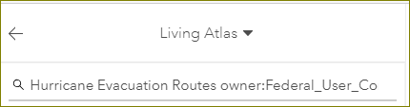
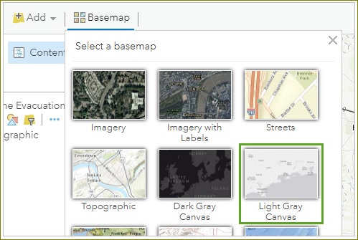
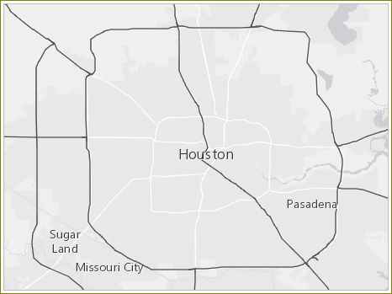
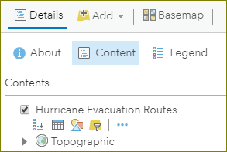
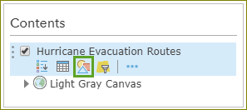
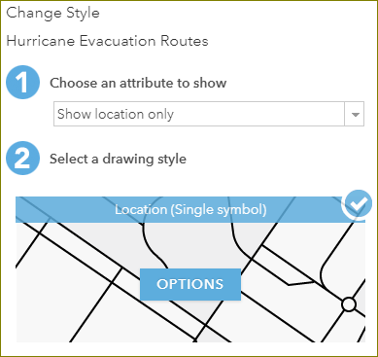
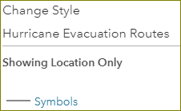
Change Styles
In the previous slide we added the layer showing the hurricane evacuation routes. To make them stand out on the map, we will now change the styles of the routes and the underlying map.
1. The layer showing the routes has been added to the map.
2. Click the back arrow and then on ‘Content’ to see the added layer names.
3. Click ‘Basemap’ to change the map to a light background.
4. In the Contents pane, point to the ’Hurricane Evacuation Routes’ layer and click the ’Change Style’ button.
5. Click ‘OPTIONS’
6. Click ‘Symbols’
Continued…

Slide 8
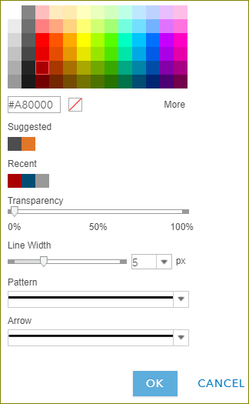
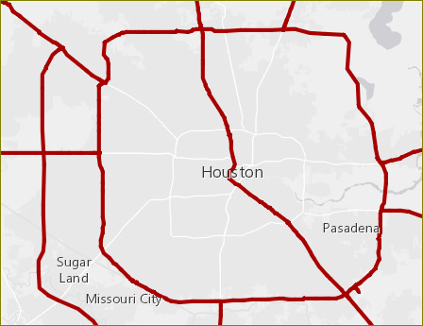
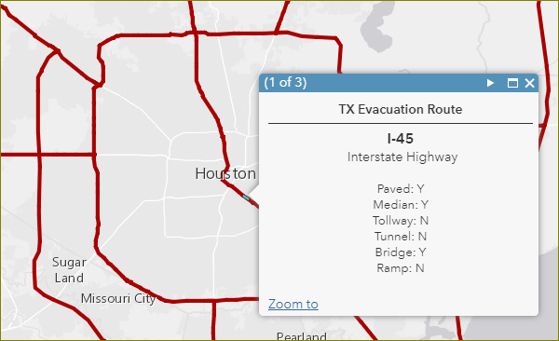
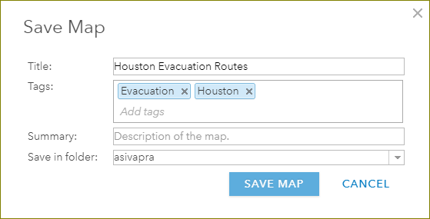
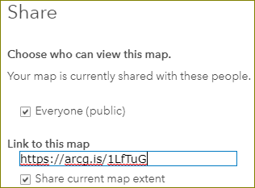
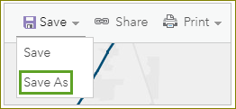
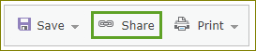
Change Styles (cont.)
1. Choose a color
2. Choose a line width
3. Click OK
4. Click anywhere on the route
5. Save the map
Next: Add Demographic Data
6. Share the map

Slide 9
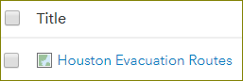
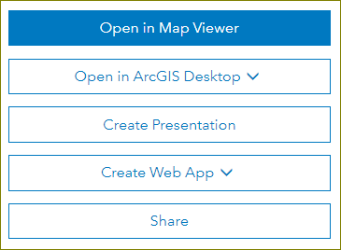
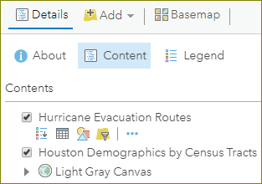
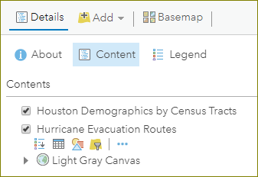
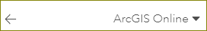
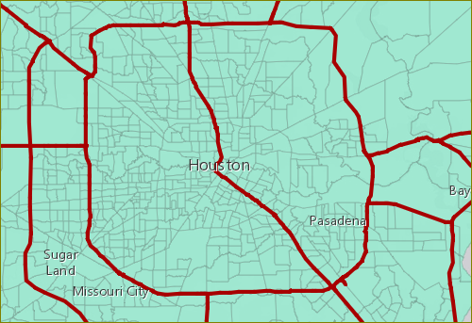
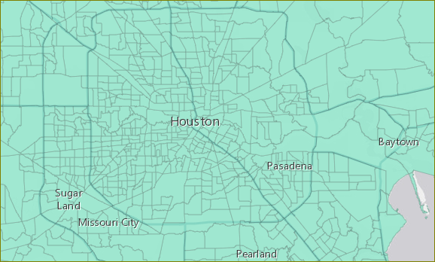
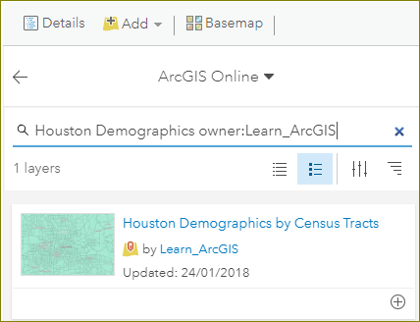
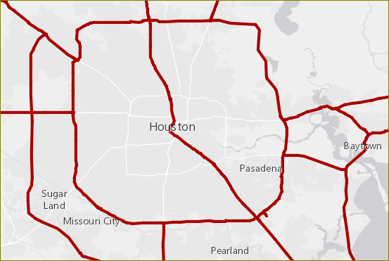
Add Demographic Data
First, you'll add a layer containing demographic data by census tract. United States census tracts divide counties into smaller geographic areas, which are useful for revealing spatial patterns.
Sign In: https://www.arcgis.com/home/index.html
1. Login and click ‘Content’
2. Click the saved map name.
3. Click ‘Open in Map Viewer’
4. Click ‘Add’, choose ‘ArcGIS Online’ and type in ‘Houston Demographics owner:Learn_ArcGIS’
5. Add the layer, ‘Houston Demographics by Census Tracts’ to the map.
6. Click back arrow and then on ‘Details | Content’
7. Click and drag “Hurricane Evacuation Routes” to top.
Next: View Attribute Table

Slide 10
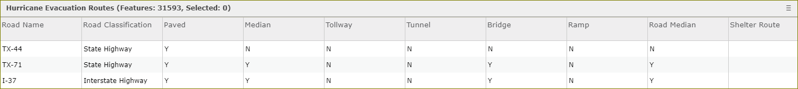
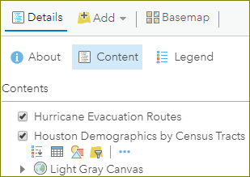
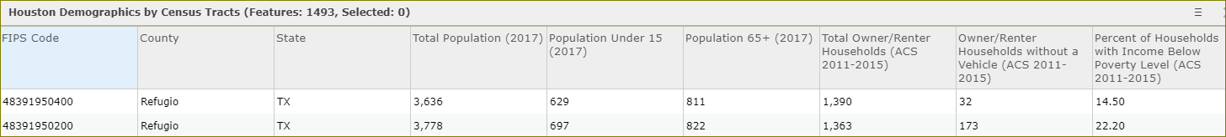
View Attribute Table
Every layer has a table that contains all attribute data about the geographic features in the layer. You'll view the table for the Houston Demographics by Census Tracts layer to find data that will help you identify areas that are vulnerable during a hurricane.
1. Click ‘Details | Content’
2. Click the layer name in the contents box.
3. Click the table icon.
Next: Style the layer with attribute

Slide 11
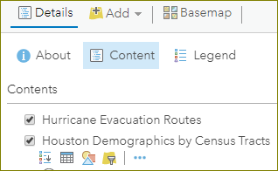
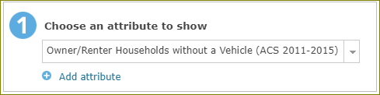
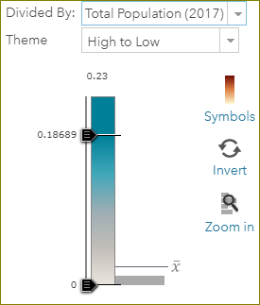
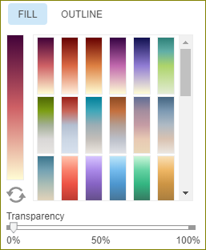
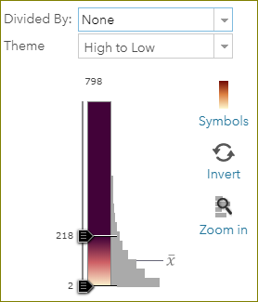
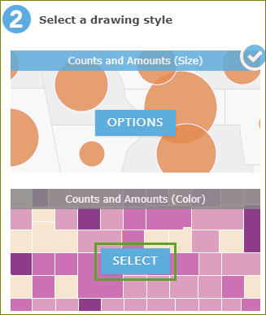
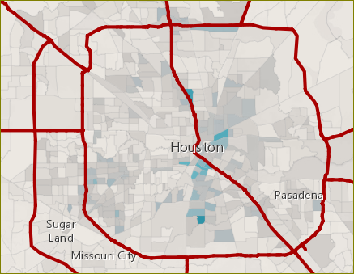
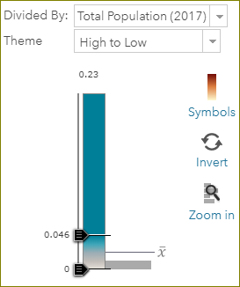
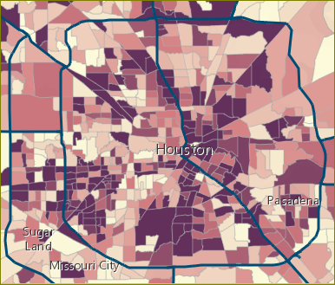
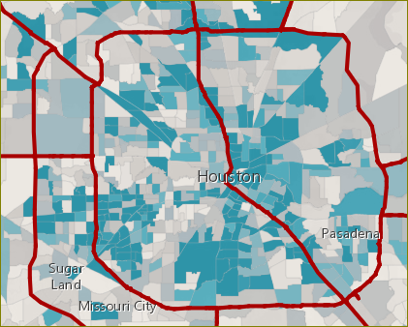
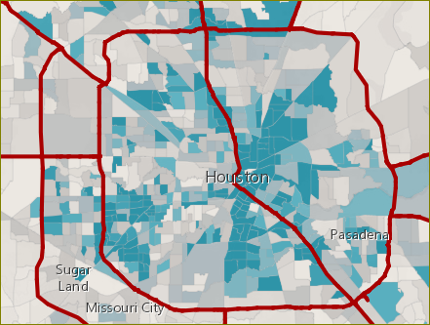

Style the Layer with Attribute
The values in the attribute tables can be applied to the layer. For instance, demography data can be displayed as color coded as in e.g. the number of households in a county. In this exercise we will show the number of households without a vehicle. Based on this data it will be possible to determine the areas that require other forms of transport for the evacuation.
1. Click ‘Details | Contents | Layer name | Change style’
5. Choose ‘Divided by: Total population (2017)’
2. Choose an attribute to show.
- Owner/Renter households wthout a vehicle
6. Slide the color bar up and down.
3. Click ‘Select’ on ‘Counts and Amounts (Color)’ (second box)
4. Click ‘Options’ on the same box
- Click ‘Symbols’ on the popup box to select colors
- Choose a color pattern.
Next: Style with normalised value

Slide 12













Style with normalised value
Currently, the layer is styled to show the total number of households without a vehicle in each census tract. However, it's possible that tracts with a higher population in general are the only ones being emphasized on the map. It'll be more meaningful for the city to concentrate assistance in tracts with a high percentage of households without a vehicle based on the total population. This percentage is called a normalized value.
1. Click ‘Details | Contents | Layer | Change Style’
2. Click ‘New Expression’
3. Click ‘Edit’ and give a title. Click ‘Save’
4. Click ‘Globals|$feature[“OwnerRenterHH_NoVehicle”]’
5. Type a ‘/’ at the end and then click ‘Globals|$feature[“OwnerRenter_HHs”]. Click ‘Test’
6. Round the result by adding ‘round((…)*100,2)’ to the expression. Click ‘Test’
7. Click ‘OK’
Next: Customise the Pop-up

Slide 13












Customise the Pop-up
Like the Hurricane Evacuation Routes layer, the Households Without a Vehicle layer has preconfigured pop-ups. However, the layer's pop-up was configured to show only total values of households without a vehicle, not percentages. Because you styled the layer with percentages, you'll customize the pop-up to show similar information.
1. Click on a tract to see the pop-up
2. Click the X to dismiss the pop-up
3. Click ‘Details | More Options’
4. Click ‘Configure Pop-up’
5. Click ‘Add’
6. Click ‘Existing’ and choose an expression. Press OK
7. Click ‘CONFIGURE’
8. Enter the expression and text to follow. Press OK
9. Click OK on a Configure Pop-up window.
10. Click on a tract to see the pop-up
Next: Interactive Web App

Slide 14









Create a Web App
A web app is a customized user interface that enhances your map's appearance, adds (or removes) functionality, and helps you integrate the map with other media. You can choose from a variety of configurable templates, depending on how you want to display your map. You simply want to showcase your map to the public, so you'll configure a Basic Viewer app template with only a few standard navigation tools.
1. Click on ‘Share’
2. Click ‘Create a web app’
3. Choose a template
4. Click ‘Create web app’
5. Enter title, keyword tags and summary.
6. Click ‘Done’ and wait until map is generated.
7. Click ‘Save’
8. Click ‘Launch’
9. Copy the URL for sharing.
Next: Advanced Usage of ArcGIS Online
https://www.arcgis.com/apps/Directions/index.html?appid=258ba08dfe2c422ca37e76c83d50834f

Slide 15
Advanced Usage of ArcGIS Online
While a facility to add GSKY Web Map Service into ArcGIS is an important step towards wider usage of the service, providing pre-created examples to demonstrate the use of GSKY may attract the users even better.
In the tutorial given above, we have seen how to create a “Web App” that is free-standing and can be accessed through the web. The Web App, however, is static and cannot be changed by the user.
In this next section we will show how data can be published so that a user can create their own maps. Such data may include map layers as well as accessory data.
The power of ArcGIS is in the facility to share pre-defined maps and associate date as free-standing projects for the world to see. To create a project one needs an ANUPublisher Account. You may be able to get it by requesting through the service portal. It is unsure whether ANUPublisher accounts will be given out to anyone outside the Fenner School of Environment and Society (FSES) who manages the ESRI Australia accounts for the ANU. It may be required to speak first to a contact given below.
FSES Contacts:
Brendan Meyer
02 6125 0349
brendan.meyer@anu.edu.au
Bruce Doran
02 6125 3704
Bruce.Doran@anu.edu.au
Phil Greaves
02 6125 4374
phil.greaves@anu.edu.au
John Boland
02 6125 4473
john.boland@anu.edu.au
What is ArcGIS Online?
ArcGIS Online is a web-based GIS that makes geographic content and analysis accessible to your entire organization. These resources can be made available to members of the organization or the general public. Because the content is hosted on the web, it can be accessed any time on any device, or even integrated with other enterprise software, such as Microsoft Office. In addition to simply providing existing content, members of the organization can add and create new content to host on the site. Members, executives, field crews, or even the community can complete their own analyses and create their own content. [^{Ref}]
Next:

Slide 16




Using ArcGIS Online with GSKY
In this section we will show how to display GSKY Web Map Service (WMS) in ArcGIS Online.
It is assumed that you have an ArcGIS Online account. If not, see slide 5 to sign-up for one.
STEPS
Login to ArcGIS Online
Click on ‘Map’ and then on ‘SIGN IN’
Choose a sign in method…
ArcGIS Login – if you have created a personal account.
Enterprise login – if you have an institutional account.
Facebook or Google – These do not seem to work.
Next: Create a Map and add GSKY Layers

Slide 17



Add GSKY Layers
Click ‘Add’ and select ‘Add Layer from Web’
Choose ‘A WMS OGC Web Service’
Enter the GSKY end point URL.
Click ‘Add Custom Parameters’
Click ‘Add Parameter’
Type ‘time’ under Parameter’
Type date in UTC format.
Click ‘Layer Only’
Click ‘Get Layers’
Next: Select Layers

Slide 18



Add GSKY Layers (Contd…)
Click ‘Layers’ to uncheck all layers.
Check required layers alone.
Or, click ‘Layers’ again to check all layers (preferred).
Click ‘ADD LAYER’
Next:

Slide 19


The KML Method - DEA
In this section we will show how to display GSKY layers via KML in ArcGIS Online.
It is assumed that you have an ArcGIS Online account. If not, see slide 5 to sign-up for one.
STEPS
Login to ArcGIS Online (see slide 16 for details)
Click on ‘Map’ and then on ‘SIGN IN’
Choose a sign in method…
ArcGIS Login – if you have created a personal account.
Enterprise login – if you have an institutional account.
Facebook or Google – These do not seem to work.
Create the KML (DEA)
Open the wrapper web page.
Choose from the dropdown lists…
A layer (e.g. 16-day LS8 Surface Reflectance)
Date (only a single date can be selected)
Region (e.g. Australia, NSW, ACT, etc.)
Method (“Directly from GSKY” or “From Cached Tiles”)
Resolution (Low, Medium or High)
Click ‘Create KML’
Depending on the size of bounding box and resolution, it can take a few seconds to a few minutes.
Click ‘Copy the URL’
Go back to the ArcGIS Online page.
Click ‘Add | Add Layer from Web | A KML File’ and paste the URL.
Click ‘Add Layer’
Depending on the size of bounding box and resolution, it can take a few seconds to a few minutes.
Next: Advanced Usage

Slide 20


The KML Method – DEA (Contd…)
In this section we show how to define a region.
Bounding Box method
Crosshair method
Draw a bounding box
Click the Bbox icon
Click the rectangle drawing tool
Draw a rectangle
Click the paste button
Crosshair method
Move the map until the crosshair is at the required position.
Select the number of tiles
Click the crosshair button
Follow the steps 3-7 on previous slide.
Next: GEOGLAM

Slide 21


The KML Method - GEOGLAM
In this section we will show how to display GSKY layers via KML in ArcGIS Online.
It is assumed that you have an ArcGIS Online account. If not, see slide 5 to sign-up for one.
STEPS
Login to ArcGIS Online (see slide 16 for details)
Click on ‘Map’ and then on ‘SIGN IN’
Choose a sign in method…
ArcGIS Login – if you have created a personal account.
Enterprise login – if you have an institutional account.
Facebook or Google – These do not seem to work.
Create the KML (DEA)
Open the wrapper web page.
Choose from the dropdown lists…
A layer (e.g. 16-day LS8 Surface Reflectance)
Date (multiple dates can be selected)
Region (e.g. Australia, NSW, ACT, etc.)
Click ‘Create KML’
Click ‘Copy the URL’
Go back to the ArcGIS Online page.
Click ‘Add | Add Layer from Web | A KML File’ and paste the URL.
Click ‘Add Layer’
See slide 20 for drawing a bounding box.
Crosshair method does not work with GEOGLAM.
Next:

Slide 22
Using ArcGIS Online with GSKY
Next:

Slide 23
Using ArcGIS Online with GSKY
Next:

Slide 24






Acknowledgements

